Slide 1

Angular and Boilerplate application
department Of business informatics and operational management
Thomas Derave

Slide 2
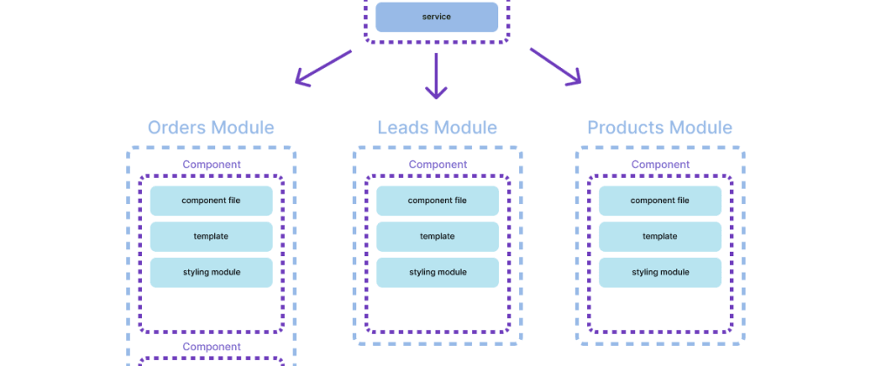
Modular

Slide 3
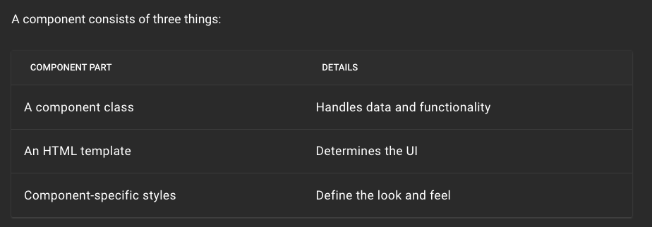
Modular
ng generate component newComponent

Slide 4
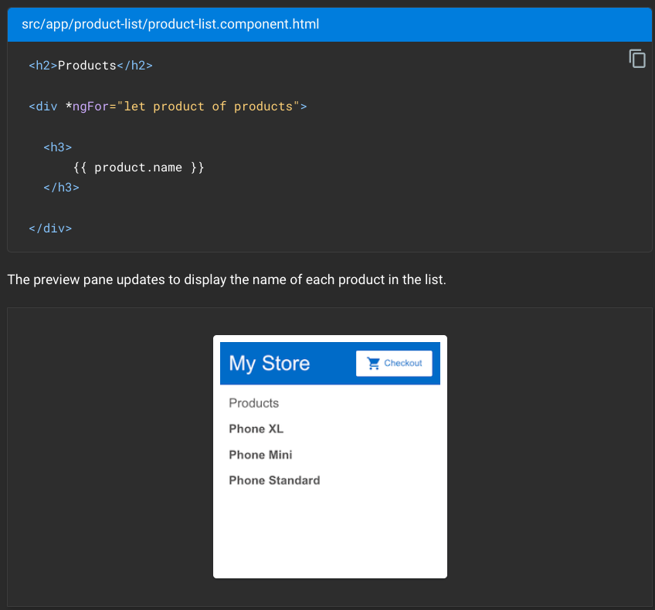
*ngfor

Slide 5
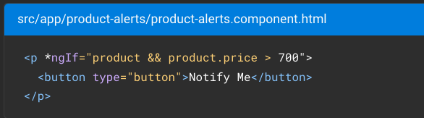
*ngIF

Slide 6
Boilerplate application
Github classroom: https://classroom.github.com/a/D7OT9P8N
Steps:
Install Angular and Node: https://angular.io/guide/setup-local
Clone the repository:
https://docs.github.com/en/repositories/creating-and-managing-repositories/cloning-a-repository
3. Check the read.me file

Slide 7
Boilerplate application
Backend Server:
Change the credentials user, password, and DB in nodejs_backend/app/config/db.config.js via vscode: https://code.visualstudio.com/
Open a terminal in VS code and run cd nodejs_backend to enter the backend folder
npm install to install the packages
If you use a Database on the ugmarket.ugent.be server, connect with VPN to vpn_ugent using Cisco AnyConnect: https://helpdesk.ugent.be/vpn/asa.php
node app.js to start the backend server, it will listen for HTTP requests on port 3000 by default.

Slide 8
Boilerplate application
Frontend
open a second terminal and run cd cd angular_frontend to enter the frondend folder
npm install to install the packages
ng serve to start the frontend server. Navigate to http://localhost:4200/. The app will automatically reload if you change any of the source files.
If you offer an offline service, get an access code for mapbox: https://www.mapbox.com/ and fill it in the environment.ts file.

Slide 9
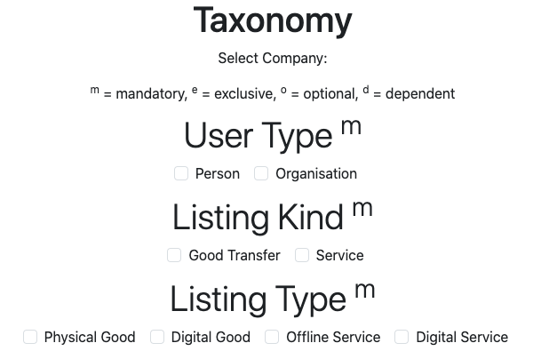
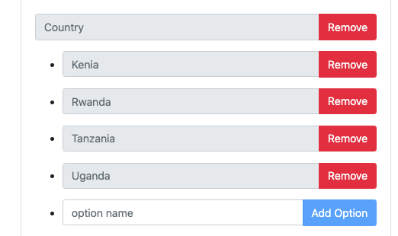
Boilerplate application
Select Business Model properties
Create a new platform company by altering the companyName in the angular_frontend/src/app/services/company.service.ts
Navigate to http://localhost:4200/taxonomy to select the business model properties of the taxonomy
Navigate to `http://localhost:4200/categories` to add categories and options

Slide 10

Thomas Derave
PhD Student and assistent
Faculty of Economics and Business Administration
Department of Business Informatics and Operations Management
thomas.derave@ugent.be
www.model-a-platform.com

